Slide 1


Slide 2


OTP
One-Time Password/Pin

Slide 3
VoIP or Voice over Internet Protocol
offers one of the most cost effective modes of telecommunication. VoIP technology combines the technologies of internet and traditional telephony and brings out such a mode of telecommunication which uses the internet for making calls. And as already mentioned, VoIP is one of the cheapest means of communication available.

Slide 4


Slide 5
Authentication is very important in modern applications as it identifies users and allows them access to resources and content.
OTP or One-Time Password or One-Time Pin is a fast and effective way to verify the mobile/phone number of a user.
Usually, OTP is sent to the user’s mobile number via SMS/call.

Slide 6
OTPs overcome many shortcomings of traditional passwords because they are not reusable and, therefore, are not vulnerable to replay attacks, in which valid usernames and passwords are captured in network traffic and used to fool a system into granting access by replaying the request.

Slide 7

Additionally, because OTP delivery is in real time, unexpected OTP messages can alert users of hacking attempts, allowing them to investigate and take necessary action before it’s too late.

Slide 8
Means of receiving OTP:
Text
Email
Call

Slide 9
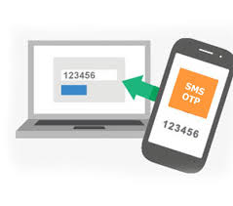
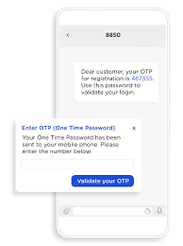

Slide 10
OTP via Text:
Occasional SMS delivery failures may occur
If Do-Not-Disturb is activated, charges are placed on the text if the receiver receives it or not.

Slide 11

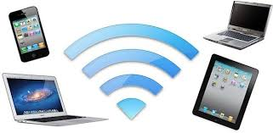

Slide 12
OTP via Email:
The main problem that people complain about the OTP via mail is
Security and
internet connectivity/ quality.

Slide 14
OTP via Call:
Here, the spoken pin is received as a phone call on the user's mobile. The pin will not be stored on the user's phone and Call allows you to reach users with limited sight.

Slide 15
OTP via Call:
Due to the good quality and cost efficiency of our very own WifiCall, the internet connection, stability and speed are excellent hence, the OTP is received without any interference.

Slide 16
OTP via Call:
Avoids security issues inherent in texting or emailing sensitive data; the pin stays between the end-user and the server.

Slide 17
OTP via Call:
WifiCall offers low call cost for all domestic and international calls as well.

Slide 18
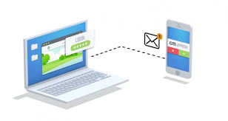
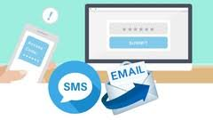

Slide 19
BENEFITS
Cheaper
Secure
Independent of Internet
Frees the inbox
Fast and reliable delivery
Worldwide delivery under 10 seconds

Slide 20
Thanks.

